Slide 1
SIMULATION OF BINARY MULTIPLIER
INNOVATIVE PROJECT REPORT
2K19/CO/319
RITIK SINGH

Slide 2
Introduction
A binary multiplier is an electronic circuit used in digital electronics, such as a computer, to multiply two binary numbers.
The two numbers are more specifically known as multiplicand and multiplier and the result is known as a product.
It is built using binary adders.
A variety of computer arithmetic techniques can be used to implement a digital multiplier.
Most techniques involve computing a set of partial products, and then summing the partial products together.

Slide 3
Objective:
The project is about simulating a binary multiplier which are used for reducing partial products and computing faster results using adders.
The architecture of the multiplier is divided into three stages- a partial product generation stage, a partial product addition stage and final addition stage.
Arithmetic and Logic Unit (ALU) is a critical element in a CPU and multiplier is one of the important element in the ALU.

Slide 4
ADDERS
In electronics, an adder is a digital circuit that performs addition of two or more numbers.
Adders can be constructed for many numerical representations, such as Binary-coded decimal or excess-3 
Adders are different types in generally

Slide 5
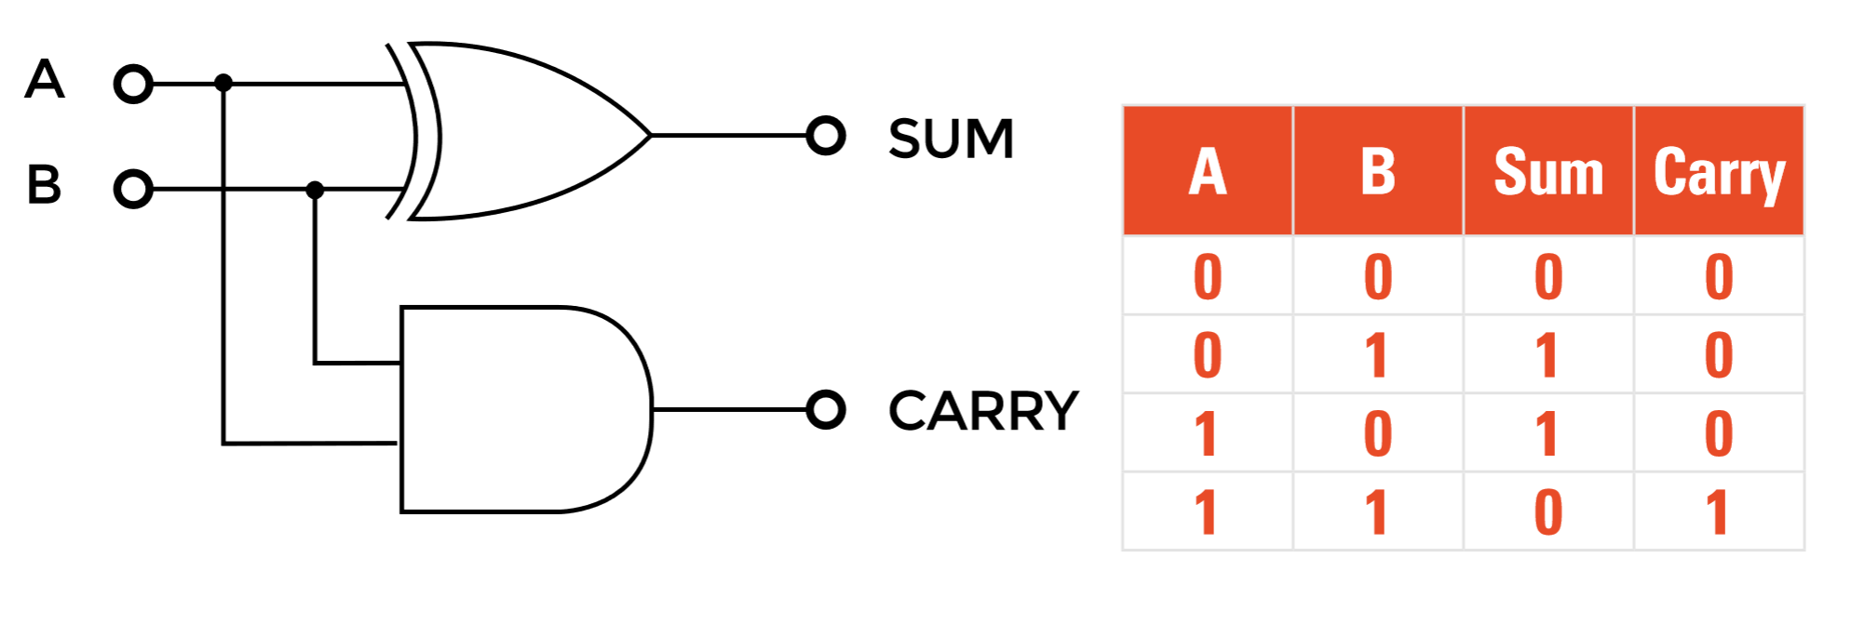
HALF ADDER
The half adder adds two single binary digits A and B. 
It has two outputs, sum (S) and carry (C).

Slide 6
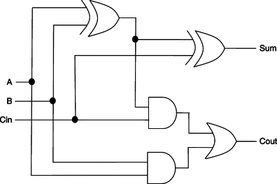
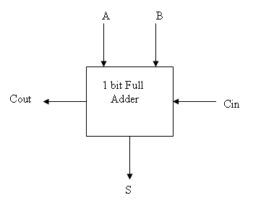
FULL ADDER 
A full adder adds three one-bit numbers, often written as A, B, and Cin. 
A and B are the operands, and Cin is a bit carried in from the previous less significant stage.

Slide 7
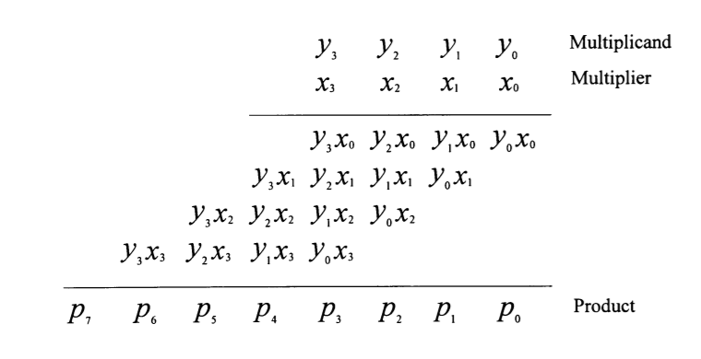
MULTIPLICATION
Multiplication process has three main steps:
Partial product generation
Partial product reduction
Final addition.
The common multiplication method is the “add and shift “algorithm.

Slide 8
Example:
Let us take an example of multiplying two binary numbers as follows. The process is similar to multiplying two decimal numbers, with a difference that the resulting numbers are all binary.
110 = 6
X 011 = 3
-------------------------
1 1 0 ; 110 X 1 (Shifted one position left)
1 1 0 x ; 110 X 1 (Shifted one position left)
0 0 0 x x ; 110 X 0 (Shifted one position left)
-------------------------
1 0 0 1 0 = 18

Slide 9
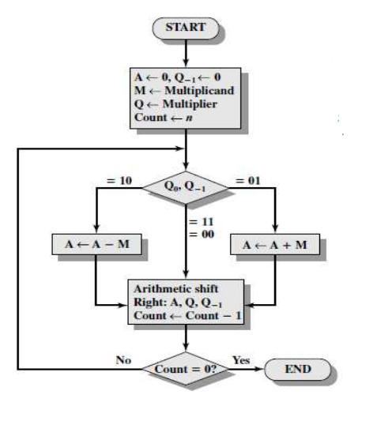
Booths Algorithm for Multiplication
A : It represents the Accumulator which stores the partial
product, It is initialized with Zero (0)
M: It represents the multiplicand
Q: It represents the multiplier,
Q₀: it represents the LSB of Q
Q₋₁ : It represents a Flip Flop which is initialized with Zero(0)
Count: It represents the counter(number of bits in M or Q)
Note: In Arithmetic Shift Right, We copy the sign bit of the
number in MSB

Slide 10
Working on the Booth Algorithm
Set the Multiplicand and Multiplier binary bits as M and Q, respectively.
Initially, we set the AC and Q_{n + 1} registers value to 0.
SC represents the number of Multiplier bits (Q), and it is a sequence counter that is continuously decremented till equal to the number of bits (n) or reached to 0.
A Q_{n} represents the last bit of the Q, and the Q_{n+1} shows the incremented bit of Q_{n} by 1.
On each cycle of the booth algorithm, Q_{n} and Q_{n + 1} bits will be checked on the following parameters as follows:
i. When two bits Q_{n} and Q_{n + 1} are 00 or 11, we simply perform the arithmetic shift right operation (ashr) to the partial product AC. And the bits of Q_{n} and Q_{n + 1} is incremented by 1 bit.
ii. If the bits of Q_{n} and Q_{n + 1} is shows to 01, the multiplicand bits (M) will be added to the AC (Accumulator register). After that, we perform the right shift operation to the AC and QR bits by 1.
iii. If the bits of Q_{n} and Q_{n + 1} is shows to 10, the multiplicand bits (M) will be subtracted from the AC (Accumulator register). After that, we perform the right shift operation to the AC and QR bits by 1.
The operation continuously works till we reached n - 1 bit in the booth algorithm.
Results of the Multiplication binary bits will be stored in the AC and QR registers.

Slide 11
Array Multiplier
Multiplication of binary numbers is performed in the same way as with decimal numbers.
The multiplicand is multiplied by each bit of the multiplier, starting from the least significant bit.
The result of each such multiplication forms a partial product.
Successive partial products are shifted one bit to the left.
The product is obtained by adding these shifted partial products.

Slide 12
Advantages of Array Multiplier
The advantages of array multiplier are,
Minimum complexity
Easily scalable
Easily pipelined
Regular shape, easy to place and route

Slide 13
Disadvantages of Array Multiplier
The disadvantages of array multiplier are as follows,
High power consumption
More digital gates resulting in large areas.

Slide 14
APPLICATIONS
These are most commonly used in various applications especially in the field of digital signal processing to perform the various algorithms.
Array multiplier is used to perform the arithmetic operation, like filtering, Fourier transform, image coding.
Commercial applications like computers, mobiles, high speed calculators and some general purpose processors require binary multipliers.
High-speed operation.

Slide 15
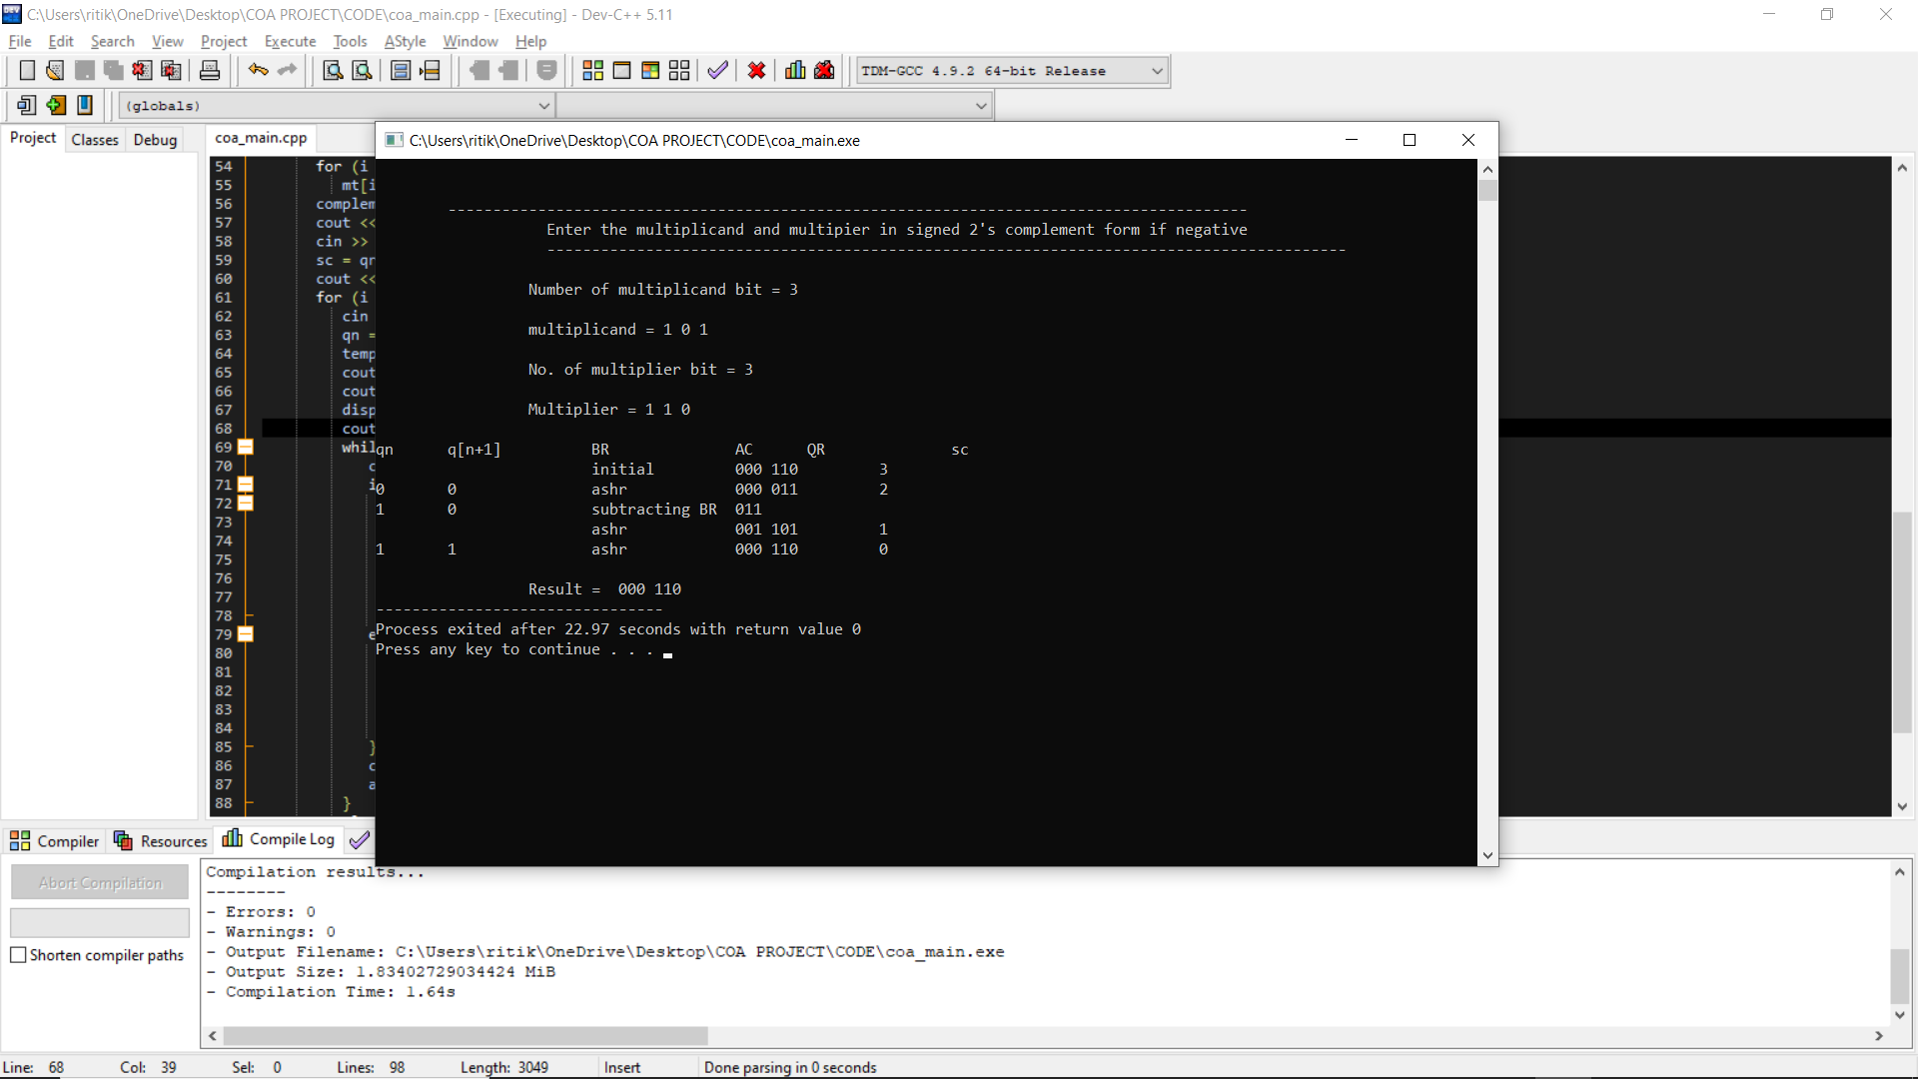
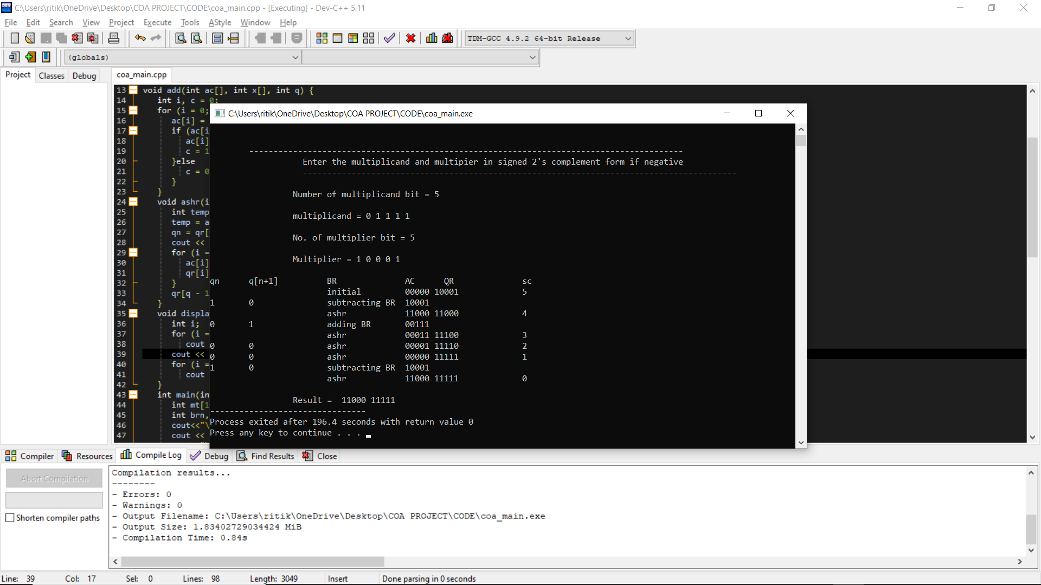
OUTPUT:
CODE IN THE WORD FILE.

Slide 16
Bibliography:
https://en.wikipedia.org/wiki/Binary_multiplier#:~:text=A%20binary%20multiplier%20is%20an,to%20implement%20a%20digital%20multiplier.
https://en.wikipedia.org/wiki/Multiplication_algorithm
https://vlsiuniverse.blogspot.com/2013/05/binary-multiplier.html#:~:text=Binary%20multiplication%20process%3A%20A%20Binary,provide%20the%20result%20as%20output.&text=The%20two%20numbers%20A1A0%20and,a%204%2Dbit%20output%20P3P2P1P0.
https://www.cs.columbia.edu/~martha/courses/3827/sp11/slides/2bit_multiplier_soln.pdf
https://www.electricaltechnology.org/2018/05/binary-multiplier-types-binary-multiplication-calculator.html
https://technobyte.org/multiplier-2-bit-3-bit-digital/
https://electronics.stackexchange.com/questions/99813/3-bit-multipliers-how-do-they-work/99837
https://inst.eecs.berkeley.edu/~eecs151/sp18/files/Lecture21.pdf
https://www.electronicshub.org/binary-multiplication/
https://www.sciencedirect.com/topics/engineering/binary-multiplication
https://en.wikipedia.org/wiki/Binary_multiplier

Slide 17
THANK YOU

